Slide 1

SMART ECO-ROUTING SYSTEM FOR SUSTAINABLE
URBAN MOBILITY
MAJOR PROJECT STAGE-1
2nd -Review
BY
BERI ASHWINI - 23BK5A0401
GAICARD SUMITH - 22BK1A0436
G.SAI KOUSHIK - 22BK1A0444
Under the Guidance of
Mrs.N.Sravani,M.tech
Assistant professor,
ECE Department
St. PETER’S ENGINEERING COLLEGE
Hyderabad

Slide 2
Overview Of the Presentation
Abstract
Base Paper
Introduction
Motivation
Literature survey
Gaps Identified
Project Objectives
Existing System
Proposed System with Block Diagram
References

Slide 3
ABSTRACT
Rapid urbanization leads to traffic congestion and air pollution, causing delays, fuel wastage, and harmful emissions (CO, NOₓ, PM).
All sensors are connected to an ESP32 microcontroller, which processes data and sends it via Wi-Fi to the Blynk IoT platform.
The Blynk app displays real-time traffic and pollution levels for routes A, B, and C.
The system dynamically suggests the most efficient and eco-friendly route based on live data.
Output is shown on both LCD display and Blynk app dashboard.
Helps reduce congestion, fuel consumption, and emissions, promoting smart and sustainable urban mobility aligned with SDG 11.

Slide 4
BASE PAPER
Title of the Base paper:
"Eco-Routing Algorithm for Sustainable Urban Traffic and Pollution Management Supporting SDG 11"
APA Citation:
Shahul Hammed, S., Preethi, C., Haripriya, K., Pavalarajan, S., Gowtham, M. R., & Krithick, N. A. (2025). Eco-routing algorithm for sustainable urban traffic and pollution management supporting SDG 11. Proceedings of the International Conference on Machine Learning and Autonomous Systems (ICMLAS-2025). IEEE. https://doi.org/10.1109/ICMLAS64557.2025.10969070
Base Paper Introduction:
The base paper presents an eco-routing algorithm designed to reduce traffic congestion and urban air pollution. It focuses on selecting routes not only based on speed or distance, but also considering environmental factors. The approach supports SDG 11 by promoting sustainable and efficient urban mobility.

Slide 5
INTRODUCTION
This project aims to reduce traffic congestion and air pollution in cities.
Our project gives a better route by checking real-time traffic and pollution levels.
Helps in saving fuel, reducing travel time, and lowering harmful emissions.
Promotes clean, safe, and smart transportation systems within city environments.
Aligned with Sustainable Development Goal 11 – Sustainable Cities and Communities.
Focuses on selecting environmentally friendly and less crowded travel routes.Beneficial for daily commuters, smart mobility applications, and urban planning systems.

Slide 6
MOTIVATION
Rapid growth of vehicles in cities is causing severe traffic congestion.
Increasing air pollution from vehicles is affecting public health and the environment.
Most existing navigation systems do not consider environmental factors while suggesting routes.
There is a strong need for sustainable and smart traffic solutions in urban areas.
Eco-routing can help reduce fuel consumption and minimize harmful emissions.
Supporting green mobility contributes to building cleaner and smarter cities.
The project aligns with the global goal of creating sustainable cities under SDG 11.

Slide 7
LITERATURE SURVEY
S.NO | TITLE | AUTHOR | YEAR | SUMMARY
1 | Traffic and Pollution Control Using Smart Routing Algorithm | Shahul Hammed et al. | 2025 | Proposes eco-routing based on traffic and emission levels to reduce pollution.
2 | Eco-Routing for Sustainable Urban Mobility | Kumar & Reddy | 2023 | Focuses on reducing CO₂ emissions through environmentally aware route planning.
3 | Smart Traffic Navigation Systems Using Real-Time Data | Thomas & Mehta | 2022 | Uses live traffic data to improve travel time and reduce congestion.
4 | Sustainable Transport with Data-Driven Route Optimization | Sharma et al. | 2021 | Highlights the importance of dynamic data for eco-friendly urban routing.
5 | Environmental Impact-Based Navigation Systems for Urban Areas | Patel & Chauhan | 2020 | Recommends route suggestions based on air quality and noise pollution levels.
6 | Green Mobility and SDG 11: Smart Routing Applications | Saito & Semba | 2022 | Connects sustainable routing approaches to global urban development goals.
7 | A Study on Smart Urban Mobility Using Environmental Sensors | Roy et al. | 2021 | Discusses integration of pollution sensors in traffic systems for routing.
8 | Route Optimization Techniques for Emission Reduction in Smart Cities | Tiwari & Nanda | 2023 | Describes algorithms for selecting routes that lower fuel use and emissions.

Slide 8
GAPS IDENTIFIED
Most existing navigation systems focus only on shortest or fastest routes, not on environmental impact.
Lack of integration between real-time traffic data and pollution/emission levels in current routing applications.
Minimal efforts made to suggest routes that prioritize fuel efficiency and reduced emissions
Limited personalization for users who prefer eco-friendly or low-pollution travel options.
Existing systems do not contribute directly to Sustainable Development Goals like SDG 11.
Absence of smart feedback or learning mechanisms to improve routing decisions over time.
Need for affordable, real-time, and scalable solutions that cities can implement in their traffic systems.

Slide 9
PROJECT OBJECTIVES
To design a smart routing system that reduces urban traffic congestion and air pollution.
To develop an eco-routing algorithm that suggests the most environmentally friendly path.
To utilize real-time traffic and environmental data for dynamic route selection.
To promote fuel-efficient and time-saving travel for urban commuters.
To support sustainable transportation and contribute to SDG 11 – Sustainable Cities and Communities.
To improve overall travel experience while reducing carbon emissions and health risks.
To demonstrate the effectiveness of green routing through simulations or prototype models..

Slide 10
BLOCK DIAGRAM OF THE EXISTING SYSTEM
User input
GPS Based Navigation System
Route Calculation (Shortest/Fastest)
Route Display on User Device
Route Navigation

Slide 11
EXISTING SYSTEM
Current navigation systems like Google Maps and Waze are widely used for route planning.
These systems suggest routes based on shortest distance or estimated travel time.
Traffic updates are considered, but environmental factors like pollution levels or fuel efficiency are ignored.
There is no feature to suggest eco-friendly or low-emission routes.
The existing systems do not support dynamic decision-making based on real-time air quality or carbon footprint.
Hence, they are not aligned with sustainability goals such as SDG 11 – Sustainable Cities and Communities.

Slide 12
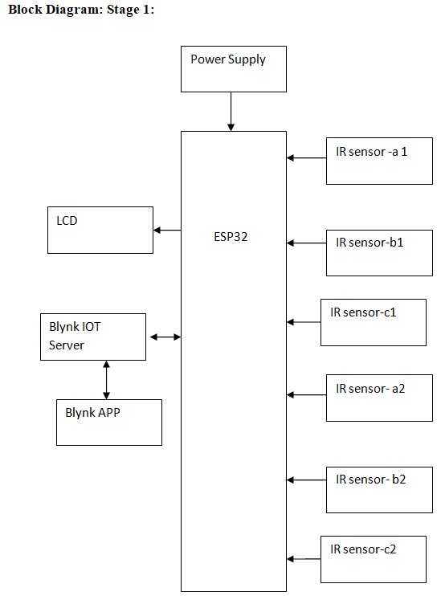
BLOCK DIAGRAM OF THE PROPOSED SYSTEM

Slide 13
PROPOSED SYSTEM
The proposed system aims to provide eco-friendly route suggestions to reduce traffic congestion and pollution.
It collects real-time data such as traffic density, air quality, and road conditions
This data is processed using a smart eco-routing algorithm that prioritizes both speed and environmental impact.
The system selects the optimal route based on the least emission and congestion levels.
It continuously updates route suggestions as traffic or pollution conditions change.
Users receive route guidance through a simple and interactive interface (e.g., mobile app).
This approach supports sustainable urban mobility and aligns with SDG 11 – Sustainable Cities and Communities.

Slide 14
HARDWARE AND SOFTWARE REQUIRED
Software Tools Used:
Arduino IDE
Blynk IoT App (Mobile & Cloud)
Embedded C / C++ Programming Language
Blynk Cloud Server
Serial Monitor (from Arduino IDE)
Hardware:
ESP32 Microcontroller
IR Sensors (Infrared Sensors)
Power Supply and Connecting Wires
Vehicles (for practical model/demo).

Slide 15
REFERENCES
Shahul Hammed, S., Preethi, C., Haripriya, K., Pavalarajan, S., Gowtham, M. R., & Krithick, N. A. (2025). Traffic and Pollution Control Using IoT-Enabled Smart Routing Algorithm. IEEE International Conference on Machine Learning and Autonomous Systems. https://doi.org/10.1109/ICMLAS64557.2025.10969070
Kumar, R., & Reddy, A. (2023). Eco-Routing for Sustainable Urban Mobility. International Journal of Smart Transportation, 7(2), 45-53.
Sharma, P., & Mehta, K. (2021). Data-Driven Route Optimization for Smart Cities. Smart City Innovations Journal, 5(1), 34-41.
Patel, N., & Chauhan, R. (2020). Environmental Impact-Based Navigation Systems for Urban Areas. Sustainable Tech Review, 4(3), 22-28.
Saito, Y., & Semba, T. (2022). Green Mobility and SDG 11: Smart Routing Applications. International Journal of Sustainable Urban Planning, 6(4), 55-61.

Slide 16


